Slide 1
The Moon
By: Cammie Goodman

Slide 2
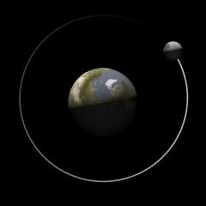
Facing up to the Moon
The moon orbits the Earth.
It takes about a month for the moon to complete its orbit.
Its orbit is nearly circular with a radius of about 380,000 km
The moon revolves in a counterclockwise direction as viewed from the perspective of the Earth’s North Pole.

Slide 3
The moon produces no light of its own.
It only reflects light.
One half of the moon is always lit by sunlight.
The dark half is shaded from the sun by the moon itself.
The portion of the moon that appears to be lit by the sun changes for the Earth-bound observer.
This change is the result of the changing relative positions of the sun, moon, and Earth.

Slide 4
When the moon is between the sun and the Earth, the lit side is facing the sun and the shadowed side is facing the Earth.
Since we cannot see any lit part of the Moon, it is not visible to us even while it is in the sky. This phase is called a new moon.
When the Earth is between the moon and the sun, the entire lit side of the moon is facing the Earth. This phase is a full moon.
The other phases of the moon fall between these extremes with apparently different amounts of the moon lit.
See the moon in action – click here

Slide 5
Phases of the Moon
Have you ever noticed the changing phases of the moon?
A phase is one of the shapes of the lit half of the moon as seen from Earth.
The moon itself is always a round ball. That shape does not change.
What does change is how much of the half of the moon is lit by the sun we can see from Earth.

Slide 6
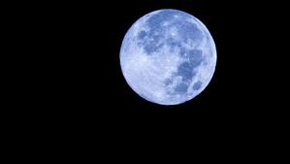
The moon is the brightest object in the night sky. But the moon does not give off its own light.
The moon reflects the light of the sun.
When an object reflects light, the light bounces off the object’s surface.
The sun always shines on half of the moon.
The shapes that we see are parts of that lit half.

Slide 8
There are four phases of the moon
There are four phases of the moon

Slide 9
New Moon
The phase called a new moon happens when the bright side of the moon faces away from Earth.
All we see is the dark side.
Most often, a new moon looks like no moon at all.

Slide 10
Full Moon
A full moon looks like a bright, round circle.
During a full moon, we see the whole bright side.

Slide 11
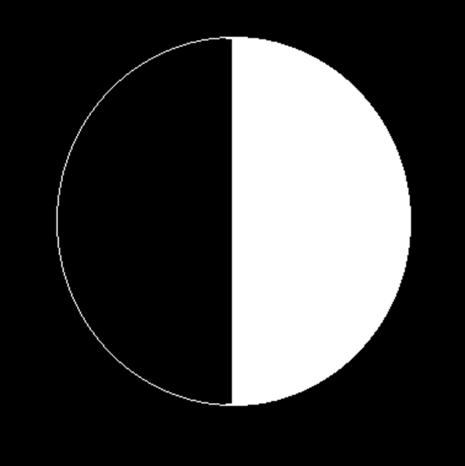
First Quarter
During the first quarter, we see half of he lit side of the moon.
The moon looks like half of a circle.

Slide 12
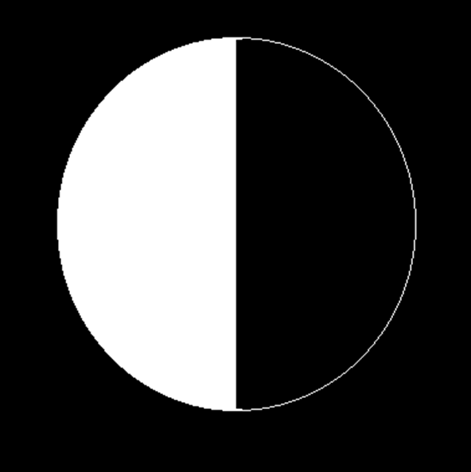
Last Quarter
During the last quarter, we see the other half of the moon’s lit side.
Again, the moon looks like half of a circle.

Slide 13
The moon also has crescent and gibbous phases.
During a crescent moon, we see less than half of the moon’s bright side.
During a gibbous phase, we see more than half of the bright side.

Slide 14
Why do we see phases?
The moon revolves around Earth, like Earth revolves around the sun.
The inside circle shows the moon revolving around Earth.
You can see that the sun always lights half of the moon.
The outside circle shows the phases that we see from Earth.
The phases change as the moon moves in its orbit
The time from one full moon to the next is about one month, or 29 ½ days. That is because it takes the moon about one month to complete one orbit

Slide 16
The Order of Moon Phases
From new moon to full moon, the lit part of the moon that we see gets larger. We say that the moon is waxing, or getting bigger.
From full moon back to the next new moon, the lit part of the moon that we see gets smaller. We say that the moon is waning.
As the moon waxes, the phases go from new moon to waxing crescent and then to first quarter, waxing gibbous, and full moon.
As the moon wanes, you first see a waning gibbous phase.
After that comes last quarter, then waning crescent, and then new moon again.

Slide 17
Click here for more interactive moon phases

Slide 18
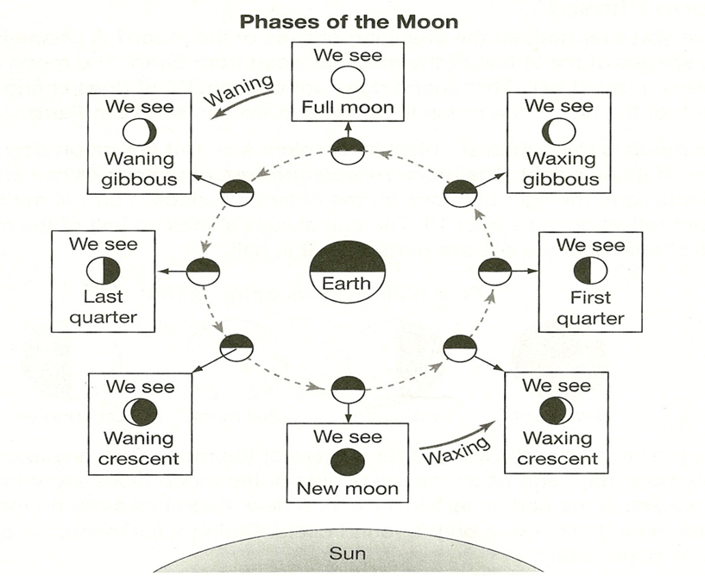

Slide 20
Interactive Moon Phases Discussion Question During which phase of the moon would it be easier to see stars in the night sky? Why?

Slide 21
1) During which phase does the moon appear to be a bright, round circle in the sky?
A. first quarter
B. new moon
C. last quarter
D. full moon

Slide 22
2) What is the main source of the moon’s light?
A. Earth
B. the sun
C. the moon
D. the stars in the night sky

Slide 23
3) Which phase of the moon is shown in the picture?
A. waxing crescent
B. full moon
C. last quarter
D. waning gibbous

Slide 24
4) Which phase comes right before the full moon?
A. new moon
B. last quarter
C. waxing gibbous
D. waning gibbous

