Slide 1


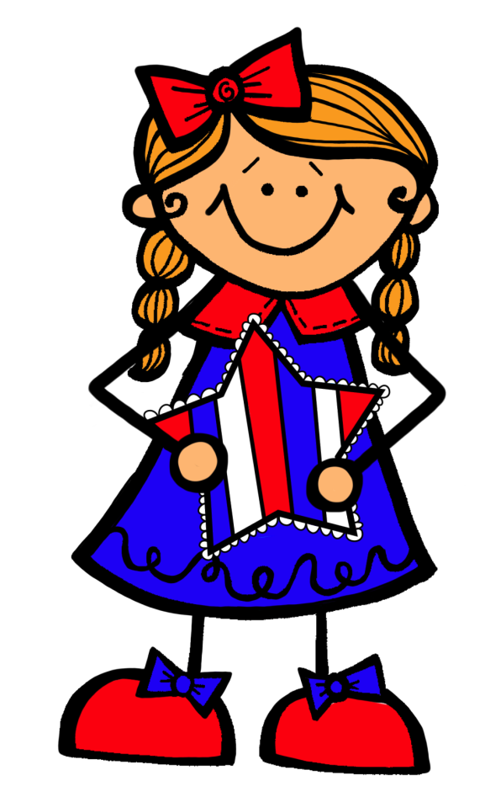

The
Constitution
and the
Constitutional
Convention
© Kara Lee 2014

Slide 2



Delegates
Remember a delegate is someone who is chosen to speak for others, or to represent them. The delegates represented each of the states and consisted of:
  Wealthy and educated landowners, business people, and lawyers
  8 of the individuals had signed the Declaration of Independence
  20 who owned slaves
  30 who had fought in the war against Britain
  Lots of individuals who had served in congress or the
  state government
  All white men .
55 delegates met in Philadelphia to discuss ways that
they could change the Articles of Confederation.
These delegates came from each of the states
except for Rhode Island.
© Kara Lee

Slide 3


Constitutional Convention
This meeting was known as the constitutional convention.
The goal of the convention was to change the Articles of Confederation because they did not give Congress enough power.
Delegates agreed to keep their debates and discussions secret
They wanted to ensure that they could speak
openly with each other, and they didn’t want
to be influenced by people outside of the
convention
© Kara Lee

Slide 4

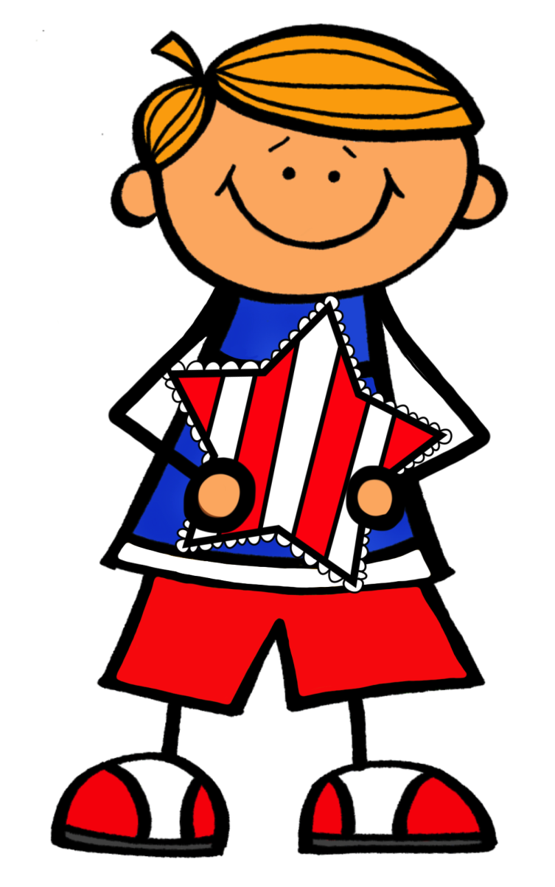
Important Leaders
There were some important delegates at the Constitutional Convention who had important roles during the convention including the following:
James Madison
George Washington
Benjamin Franklin
© Kara Lee

Slide 5

James Madison
Delegate from Virginia
Member of Congress
Wanted a new system of government
Took notes during the convention
His notes are how we know a lot about
what was said and done at the
convention.
© Kara Lee

Slide 6
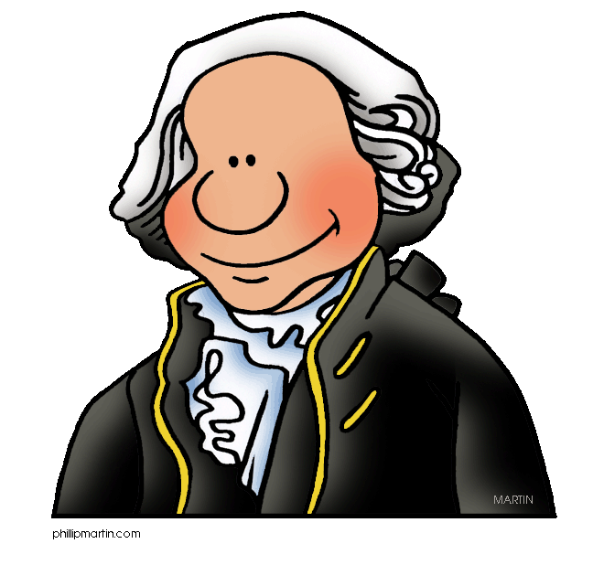
George Washington
Also a delegate from Virginia
Known as a hero of the Revolution
Delegates elected him as the president of the convention
© Kara Lee

Slide 7
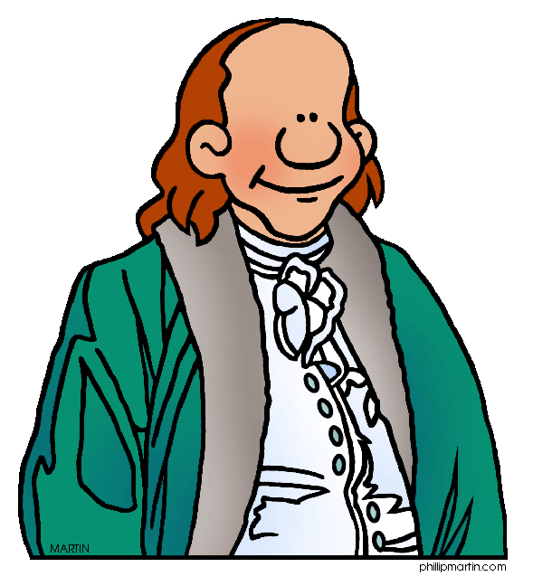
Benjamin Franklin
Delegate from Pennsylvania
Respected because of his wisdom
Had served the United States in many ways for many years
© Kara Lee

Slide 8


Federal System
Some of the delegates believed that a federal system was needed. Madison and Washington wanted this system.
A federal system is a system in which the states share power with the central government. However, in a federal
system, the central
government would have
more power than the
states.
© Kara Lee

Slide 9
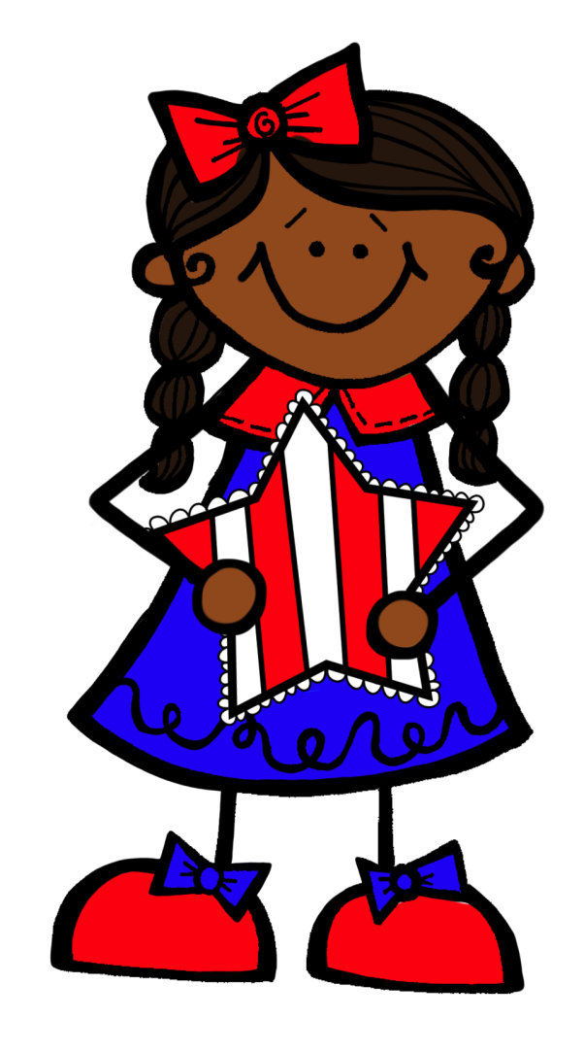
Republic
Some delegates like Madison believed that a republic was the type of government that
was needed in order to ensure that
Congress is capable of maintaining
order and protecting rights.
A republic is a government in which
the citizens elect leaders to
represent them.
© Kara Lee

Slide 10

Virginia Plan
James Madison’s plan for a new government was known as the Virginia Plan.
Edmund Randolph, governor of Virginia, described this plan to the delegates.
The plan was that there would be a federal system in which the national government was made up of three different parts or braches.
  Congress - would make the laws
  A second branch would carry out the laws
  Courts – would settle legal arguments
Most state governments already had this system in place.
Madison suggested that congress would be comprised of state representatives based on the state’s population.
In turn, large states would get more votes than small states.
© Kara Lee

Slide 11


New Jersey Plan
The delegates accepted the Virginia Plan, however, the small states did not like that large states would get more votes than small states.
In turn, the New Jersey Plan was created by these small states.
The New Jersey Plan stated that each state would be given one vote.
This would ensure that large states did not have more power than small states.
© Kara Lee

Slide 12

Great Compromise
The delegates argued about the Virginia and New Jersey Plans.
A compromise is when both sides give up something to settle a disagreement.
A delegate from Connecticut name Roger Sherman came up with a solution. His solution became known
as the Great Compromise.
He stated that Congress could be
divided into 2 parts or houses:
  Senate – each state would have an
  equal amount of representatives
  House of Representatives – the
  number of representatives in this
  house would depend on the state’s population
© Kara Lee

Slide 13
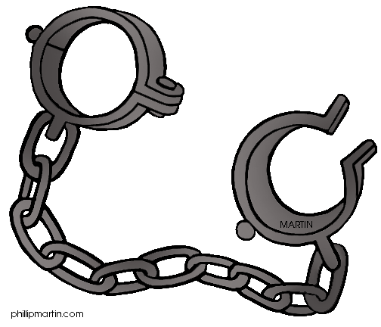
Slavery
Slavery was another problem that the delegates wanted to discuss.
Delegates argued about whether or not to stop allowing slaves to be brought into the U.S. However, southern delegates were against this. The southern delegates would not accept the constitution and the new system of government unless the slave trade would be continued.
Also, southern delegates wanted to be able to count slaves in their state’s population because it would give their state more representatives in Congress.
© Kara Lee

Slide 14
Three-Fifths Rule
After arguing lots about the issues of slavery, another compromise was made.
This compromise was known as the three-fifths rule.
The rule stated that five slaves would only count as three free people.
They also decided to continue the slave trade so that all states would support the new
government and the Constitution.
© Kara Lee

Slide 15
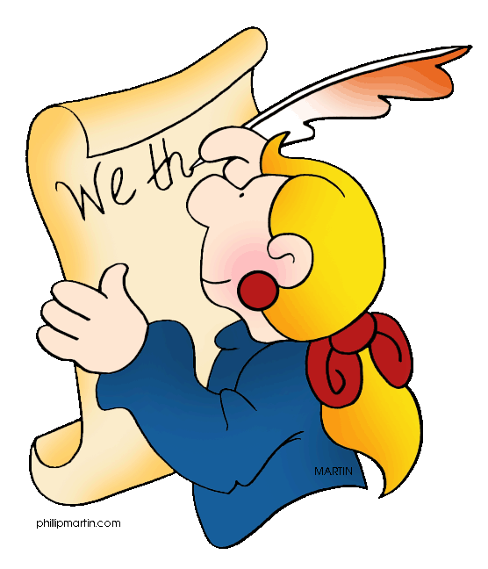
The Constitution of United States
After many hard weeks working on the new plan for their government, delegates signed a document known as the Constitution of the United States of America.
They signed the final document on September 17, 1787.
Since the Constitution is based on James Madison’s Virginia Plan, he is known as the Father of the Constitution.
© Kara Lee

Slide 16

Ratifying the Constitution
To ratify means to accept.
In order for the Constitution to be used, they needed at least nine states to ratify it.
Each state had representatives from the towns who met to decide whether or not to ratify the Constitution.
© Kara Lee

Slide 17

Federalists
Supporters of the Constitution are
called Federalists
The Federalists were very surprised by the Constitution because they were not expecting a whole new system for their government.
The Federalists were in charge of teaching the public about the new federal system and why it would be successful.
James Madison, Alexander Hamilton, and John Jay wrote essays called The Federalists to explain this.
© Kara Lee

Slide 18

Antifederalists
People who did not support the new Constitution are called Antifederalists
They did not want a federal system because they felt it would be a threat to their freedom.
They thought that the Constitution
should have a Bill of Rights, or a list
of rights that individuals have.
In turn, Federalists including James
Madison said they would add the
Bill of Rights to the Constitution.
© Kara Lee

Slide 19



Ratification
The first state that ratified the Constitution was Delaware.
The ninth state to ratify the Constitution was New Hampshire, and this made the Constitution the country’s new laws.
Eventually, all of the thirteen states ratified the Constitution.
© Kara Lee

Slide 20
Preamble
Preamble states the purposes of the Constitution.
“We the people of the United States, in order to form a more perfect Union, establish justice, insure domestic tranquility, provide for the common defense, promote the general welfare, and secure the blessings of liberty to ourselves and our posterity, do ordain and establish this Constitution for the United States of America.”
© Kara Lee

Slide 21


Terms of Use
Thank you for downloading my Constitution and Constitutional Convention PowerPoint. I hope that you enjoy using it as a valuable resource in your classroom! Please let me know if you have any questions or concerns. My email is teachersgonewild2@gmail.com.
©Kara Lee 2014
This resource entitles you to single classroom use only. Please do not share with grade level teams or district wide or post/resell any part of this resource. If you would like to share this resource with others, please purchase multiple licenses.
I’d love to hear your feedback! www.teacherspayteachers.com/Store/Teachers-Gone-Wild

Slide 22


Fonts and Clipart Credit
Houghton Mifflin Social Studies United States History Early Years: Georgia Textbook was used to referenced to assist with information
Fonts:
Clipart: http://www.mrdonn.org/clipart.html
Backgrounds:

