Slide 1
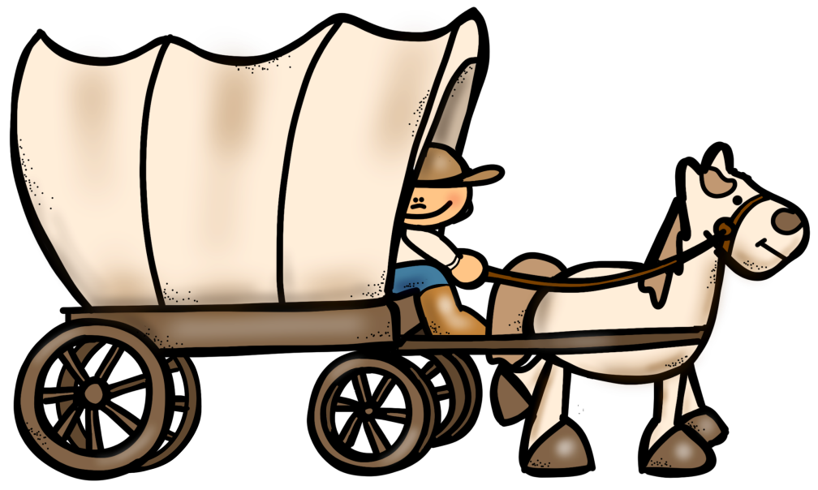
Westward
Expansion
Introduction
PowerPoint
&
Notes
© Erin Kathryn 2015

Slide 2
Exploring the Frontier
The first colonists who came to the British colonies from Europe settled east of the Appalachian Mountains.
Under the Proclamation of 1763, it was against the law for colonists to settle on American Indian land west of the Appalachian Mountains.
This did not stop people from trying to cross these mountains.
© Erin Kathryn 2015

Slide 3
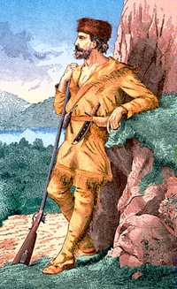
Daniel Boone
Daniel Boone was a hunter and pioneer.
A pioneer is one of the first of a group of people to enter a region.
1769 – Boone and several other men followed an Indian trail through a passage in the Appalachian in Virginia.
This trail was called the Cumberland Gap.
© Erin Kathryn 2015

Slide 4
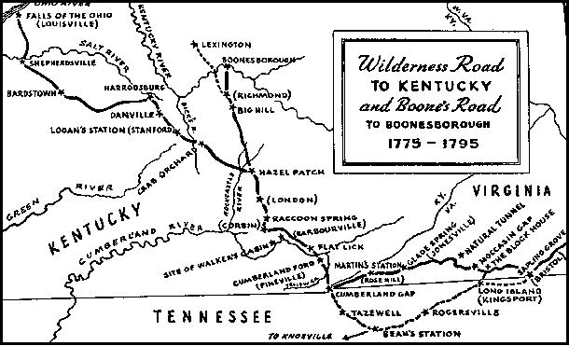
Wilderness Road
Boone helped clear a new road through the Cumberland Gap.
This new route through the mountains was called the Wilderness Road.
This new road ran 200 miles west.
Boone helped families, including his own, across the Appalachians using the Wilderness Road.
Settlers started towns in present-day Kentucky.
© Erin Kathryn 2015

Slide 5
Life on the Frontier
Late 1700s – Thousands had crossed the Appalachians.
People were in search of good, inexpensive farmland and new opportunities.
Settlers moved into a region known as the frontier.
A frontier is the edge of a country or settled region.
This frontier had already been settled by American Indians.
© Erin Kathryn 2015

Slide 6
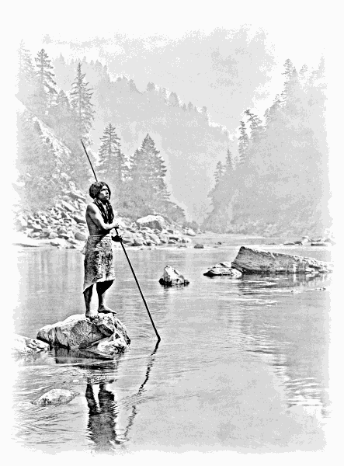
Life on the Frontier
Shawnee, Choctaw, Cherokee, and other American Indian nations built villages, farmed, and hunted on their land.
Indians and settlers fought over the land west of the Appalachian Mountains.
They also learned how to share ideas and customs from one another.
© Erin Kathryn 2015

Slide 7
Wagons
Many families used large wagons full of food and supplies to travel west.
There was often no room for people to ride in them.
The roads were rocky, dirt paths with no bridges over rivers.
Wagons often broke apart and had to be repaired.
© Erin Kathryn 2015

Slide 8
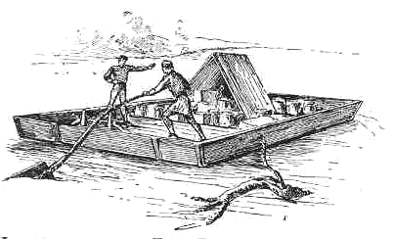
Flatboats
Floating on rivers was often easier than traveling on the poor roads.
The Ohio River was the most traveled river.
Families, supplies, and animals floated down the river in flatboats.
A flatboat was a large rectangular boat that was partially covered by a roof.
Settlers used flatboats to travel on canals, or waterways.
© Erin Kathryn 2015

Slide 9
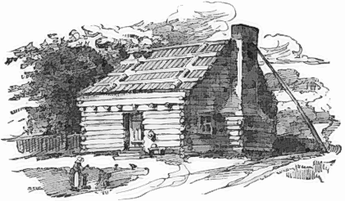
Making A Home
Pioneers cut down trees to make homes and grew corn and other grains upon arriving on the frontier.
Frontier life was hard, especially for women.
They lived far from family and friends.
While the men hunted, the women took care of the children and the farms.
Although life was difficult, settlers lived better than they had in Europe or in the east.
© Erin Kathryn 2015

Slide 10
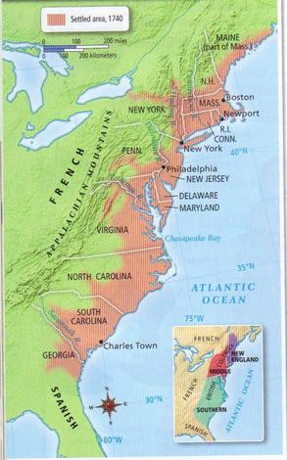
Why It Matters…
When pioneers crossed the Appalachian Mountains, they moved the boundaries of American settlement west of the original thirteen colonies.
© Erin Kathryn 2015

