Slide 1
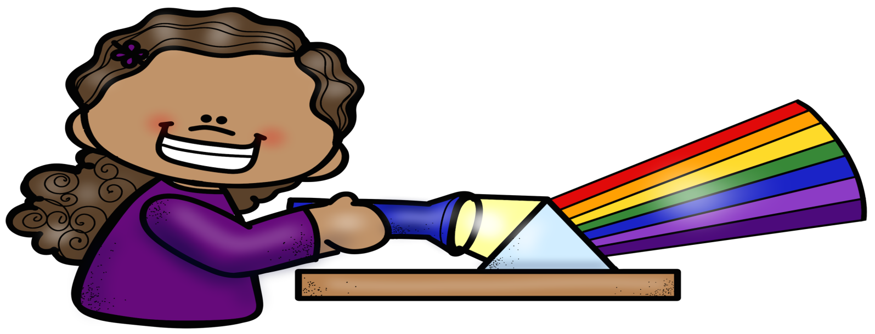
LIGHT
PowerPoint & Notes
Set
© Erin Kathryn 2016

Slide 2
What is light?
Light is a kind of energy that you can see.
Light moves in waves.
Most objects do not give off their own light.
We see objects because light waves hit the object and bounce off of it.
© Erin Kathryn 2016

Slide 3
What is light?
Light waves travel in a straight path called a ray.
When passing through different materials, light waves can bend or turn.
© Erin Kathryn 2016

Slide 4
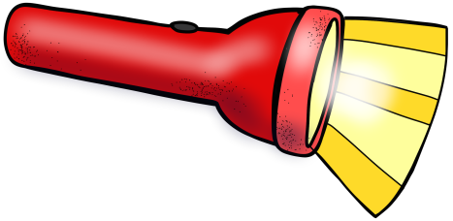
Natural vs Manmade
NATURAL | MANMADE
sun stars match fire lightning lava | lightbulb headlights flashlight streetlight computer screen
© Erin Kathryn 2016

Slide 5
Light and Matter
Depending on the type of matter light passes through, light waves will do different things.
Objects are classified as being transparent, translucent, or opaque.
© Erin Kathryn 2016

Slide 6
Transparent
You can see through objects that are transparent.
A transparent object lets all light pass through it.
For example, windows and water are transparent.
© Erin Kathryn 2016

Slide 7
Translucent
You can partly see through objects that are translucent.
A translucent object lets some light pass through it.
For example, frosted glass and wax paper are translucent.
© Erin Kathryn 2016

Slide 8
Opaque
You cannot see through objects that are opaque.
An opaque object lets no light pass through it.
For example, walls and people are opaque.
© Erin Kathryn 2016

Slide 9
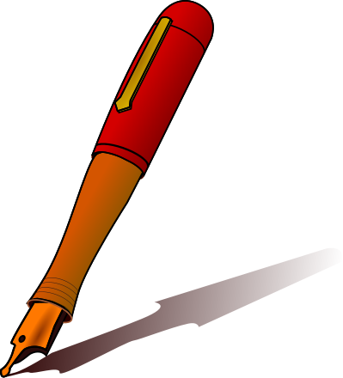
Shadows
Shadows are created when light hits an opaque object.
Some light waves hit the object and some are blocked by the object.
A shadow is a place where light does not strike.
© Erin Kathryn 2016

Slide 10
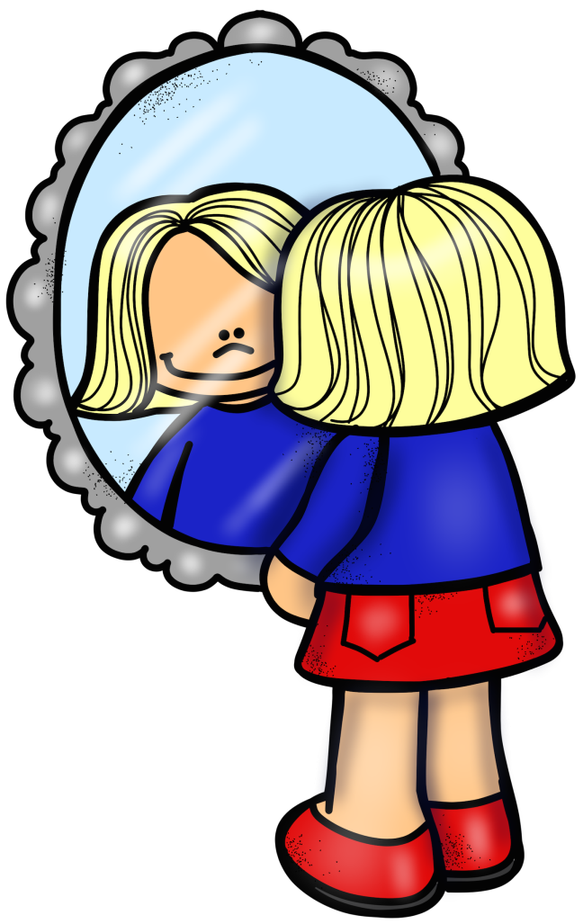
Reflected Light
Light waves move in straight lines (rays), but they change direction when they hit something.
Light waves bounce, or reflect, off most objects.
© Erin Kathryn 2016

Slide 11
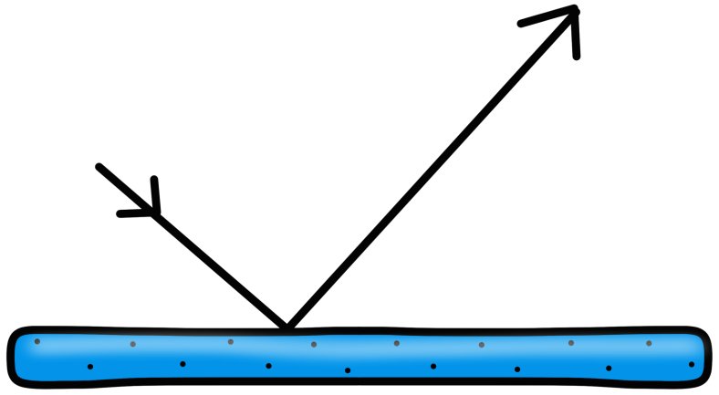
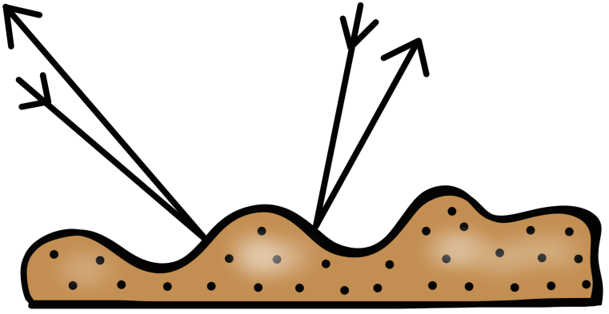
Reflection
If an object is smooth and shiny, the light waves bounce off in one direction.
If an object is not smooth, light waves bounce back in many directions.
© Erin Kathryn 2016

Slide 12
Refraction
Light waves refract, or bend, when they move from air to water.
Refracted light makes things look bent or broken.
© Erin Kathryn 2016

Slide 13
Lenses
A lens is an object that refracts light.
Lenses are curved transparent objects that bend light waves.
© Erin Kathryn 2016

Slide 14
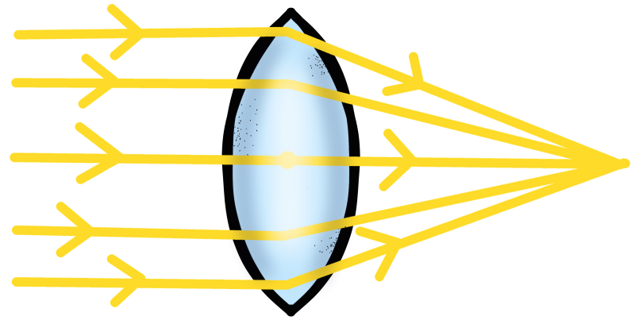
Convex Lens
A convex lens is a curved lens that makes objects appear bigger.
Convex lenses are used in telescopes and magnifying classes.
© Erin Kathryn 2016

Slide 15
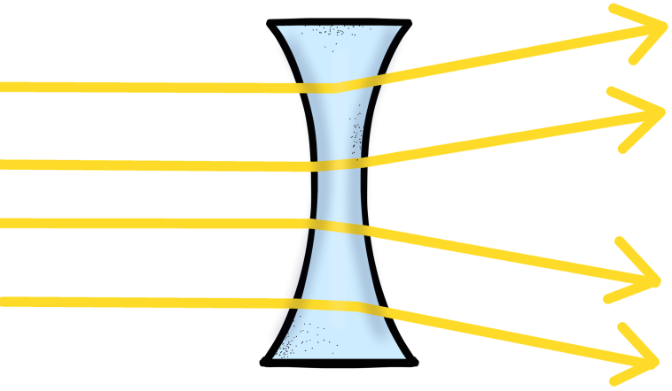
Concave Lens
A concave lens is a curved lens that makes objects appear smaller and farther away.
Concave lenses are used in car side mirrors.
© Erin Kathryn 2016

Slide 16
What is Color?
When light hits an object, the color of the light affects the way you see the object.
White light – all the colors of the rainbow
© Erin Kathryn 2016

Slide 17
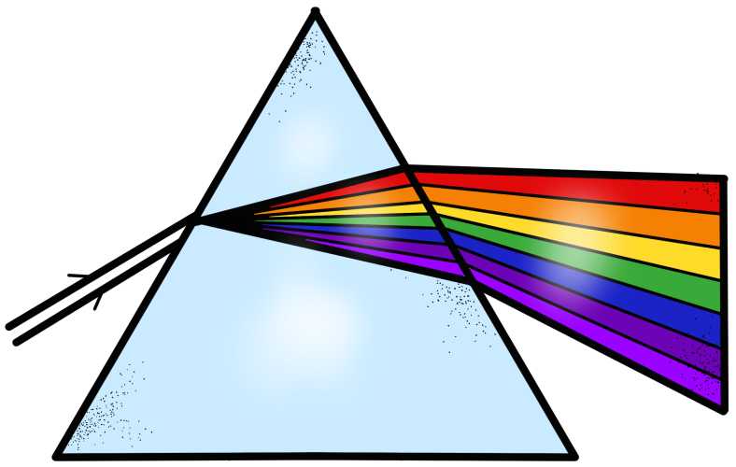
Prisms
A prism is a piece of glass or other transparent material that is shaped like a triangle.
Prisms break white light into all the colors of the rainbow.
© Erin Kathryn 2016

Slide 18
Rainbows
When it is raining, you can sometimes see a rainbow.
Rainbows occur because raindrops act like prisms.
They break white light into the colors, which forms a rainbow.
© Erin Kathryn 2016

Slide 19
How Do We See Colors?
Light shines on an object.
The object absorbs, or takes in, some of the light waves.
The object absorbs and reflects colors.
You do not see the absorbed colors, you only see the reflected colors.
All colors, but yellow, are absorbed.
Yellow is reflected.
© Erin Kathryn 2016

